Slide 1

Building a Smart Client with HTML5 and JavaScript
Aidan Ryan
Solutions Architect
@ajryan
Level: Intermediate

Slide 2
What We Will Cover
To the Web!
JavaScript MV* Frameworks
The Web Stack
Responsive Web Design
AngularJS + TypeScript
Azure Websites and Mobile Services
ASP.NET Web Pages
Web API, CSLA
Testing
Cross-cutting concerns (Security, Performance, Compatibility, etc.)
Notes:
First a general discussion of taking an app to the web – overall pros and cons.
Look at the available JavaScript MVC* frameworks and the factors that go into choosing one.
Remainder of the presentation will start on the front end and work towards the backend:
An overview of the stack chosen for the MyVote HTML5 SPA
Responsive Web Design techniques
Use of Azure Mobile Services from JavaScript
AngularJS with TypeScript
ASP.NET MVC, especially ways to leverage static typing as far into your JavaScript as possible
ASP.NET Web API serving Business Objects from CSLA

Slide 3
MyVote – HTML5 Edition
[Demo]
Notes:
[LOCAL] google registration, create poll, vote, view results
Android browse

Slide 4
To the Web!
Sweet spot ratio of code :: eyeballs :: features
Deliver on the Modern Runtime
Rapid iteration, frequent release
Cross-platform development and testing (pro/con)
Fear of JavaScript?
Notes:
Delivering an app on the web (especially using a responsive design) is the sweet spot of code-to-eyeball ratio. Everyone in this room has a browser in their pocket. You can hedge your mobile bets with a responsive design and go native if you get a hit.
“Modern” – what does that mean?? I struggled with this…. For me– where is the innovation happening. What are USERS excited about. It is NOT about trends in languages/frameworks/hot-new-buzzword
When NOT?? Feature requiring you to go straight native – GPS, e.g. architectural field survey, (accelerometer) app that burps when you drop your phone
Your distribution method is server side – you decide when an update gets pushed. You can manage multiple dev/stage/prod environments and access them all from the same client. Get your prototypes in front of people quickly.
A/B testing – as simple as standing up two servers behind a load balancer. Compare to native A/B which (far as I have seen) requires ugly inline compromises).
Initial testing can be performed from any platform. Don’t need an iOS/Android device to check basic functionality. This is, however, the biggest multi-edged sword involved: you also must test for compatibility. Luckily with careful planning you can hit a good 80/20 mark without a lot of special-case code.

Slide 5
Where did we come from?
Static DOM
Static DOM
Static DOM
Static/Dynamic
DOM
Code-Behind
Controller
Controller
Services / Data

Slide 6
Single Page Application
Master Layout
Model
View
(Dynamic DOM)
Controller
Services
Renderer
Services / Data

Slide 7
JavaScript MV* Libraries and Frameworks
 | Knockout | Backbone.js | Ember.js | AngularJS
Type | Library | Library | Framework | Framework
Templates | DOM String | String* | String | DOM
Routing | - | Yes | Yes | Yes
Additional Features |  | REST client | Components, Dependency injection, DAL, REST client | Components; Dependency injection; HTTP and REST clients
Notes:
* Backbone does not require a specific templating system, though most use Handlebars, which is string-based
Angular requires a set of workarounds and polyfills
For general back-compatibility you will need HTML5Shiv, maybe Modernizr, and probably JSON2 (for parse and stringify)
Components == markup extensions (think custom HTML tags)

Slide 8

Choosing a framework
Comfort with patterns and conventions
Current skillset
Documentation
Mindshare, longevity
http://www.funnyant.com/choosing-javascript-mvc-framework/
Notes:
Choosing a framework is informed by:
Your comfort with the patterns and conventions of the framework. You’ve used ASP.NET MVC? You’ll be happy with Knockout and Angular. Rails background? Ember.js will click. Like to compose your own architecture? Backbone.
Look at the documentation (and user-generated content out there) and get a feel for how quickly you grok it.
“Staying power” – you will need help. Look at the size and involvement of the community. Look at who backs the project and how active they are in its development

Slide 9
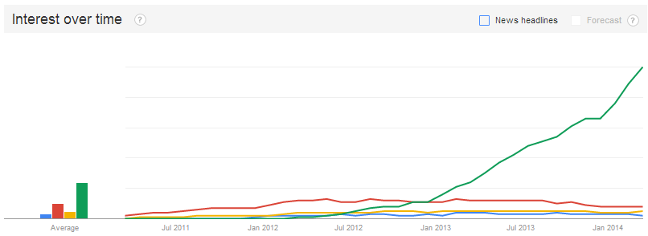
Mindshare
Notes:
Caveats:
Searchers may not include “js” suffix
Searches in English

Slide 10
Mindshare
Notes:
Total volume vs trend and stability.. (bars are “area under the curve”)
Caveats:
Searchers may not include “js” suffix
Searches in English

Slide 11
Mindshare
Framework / Library | StackOverflow Questions | GitHub Stars/Forks | Slideshare Count
Knockout | 9,778 | 4,732 / 776 | 4,404
Backbone | 13,899 | 17,313 / 3,793 | 12,480
Ember | 8,446 | 9,585 / 2,051 | 3,564
Angular | 28,530 | 21,517 / 6,721 | 12,624
Notes:
Usage is close…
Questions versus answers --- Angular SO questions, Backbone SlideShare answers.

Slide 12
The Stack
HTML5/CSS3 Responsive Design
AngularJS + TypeScript
Azure Web Sites and Azure Mobile Services
ASP.NET Web Pages (not MVC!)
ASP.NET Web API
CSLA
Azure SQL Server
Notes:
The stack, from front-end to back-end:
An HTML5/CSS3 responsive web design that is targeted at IE10+, then try to hit the 20% issues
Azure Websites for hosting, Azure Mobile Services for authentication
AngularJS client-side framework
ASP.NET web pages at the presentation layer. Opportunity for nice wins here with strong typing and HtmlHelpers
ASP.NET Web API is a great match for AngularJS $resource REST client
CSLA standardizes the business rules. One codebase FTW!
Azure SQL Server in the backend
Everything is cloud hosted and can be deployed direct from a developer desktop.

Slide 13
Responsive Web Design
Further elevate your code :: eyeball ratio
Foot in the door for mobile devices
Invest in your base template
Core technique: media queries
Notes:
The sweet spot for responsive design is a balance of development effort and reach: responsive design techniques will get your content in front of the most eyeballs, in a usable way, with the least effort.
Cheapest = design for desktop and cross your fingers on mobile. Lots of mobile users will bounce.
Most Expensive = separate designs for phone, tablet, and desktop. May deliver the most optimal experience on each device, but costs a lot more to develop *and maintain*
You will naturally deliver a consistent experience across devices. Styling, navigation, UX will be familiar and help your users transition. You also have one set of HTML and styling resources to maintain – changing one naturally changes them all.
This approach forces you to first examine the value you’re delivering, then decide how to present it. Tendency when approaching a single platform can be to dive into wireframes before the content is fully realized.
Responsive design is about delivering the greatest possible user joy regardless of the access method. It is not a dogma or a recipe, it’s more of a mindset that is focused on experience first.
DEMO:
Base template
Site.css - .left-view primary and query styles
Show difference in-browser with chrome inspector

Slide 14
Responsive Web Design
[DEMO]
Media Queries
Notes:
DEMO:
Base template
Site.css - .left-view primary and query styles
Show difference in-browser with chrome inspector

Slide 15
Azure Websites
No server, no IIS to manage
Secure configuration
Deploy from Git
Kudu
TFS Git is now supported
Monitoring
New Relic (server side)
Application Insights (client)
Notes:
Azure Websites is *excellent* for rapidly iterating on an MVC site. Deploy from Git, never touch Windows Server or IIS. How many times have you run aspnet_regiis?
Put local-only config (connection strings, server URLs, identities) in your web.config, replace appSettings in the hosted control panel
Deploy with Git Push

Slide 16
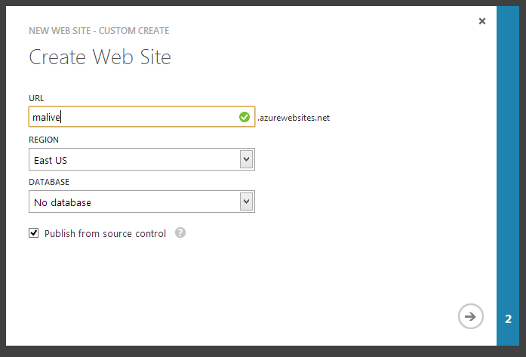

Slide 17
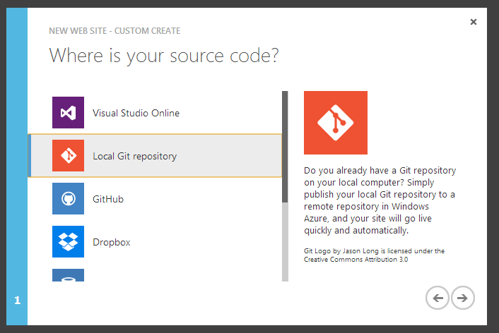

Slide 18
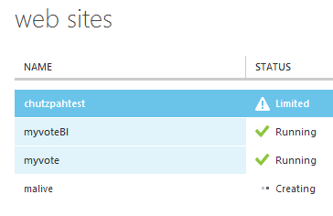
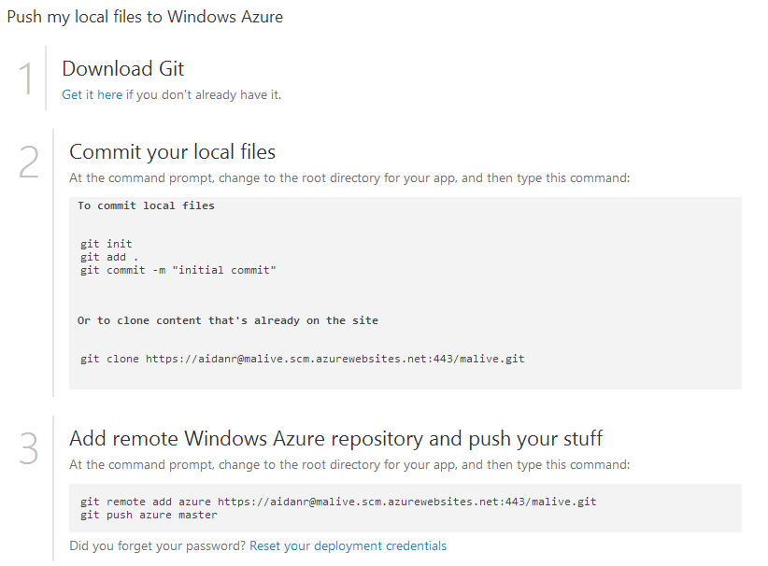

Slide 19




Azure Websites - Support

Slide 20
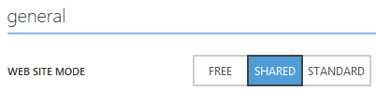
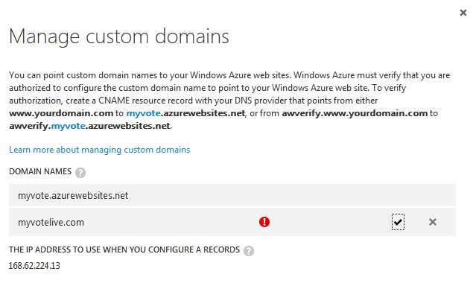
Azure Websites – Custom Domain
Type | Alias | Destination
A | @ | <Azure IP>
A | * | <Azure IP>
CNAME | awverify | awverify.myvote.azurewebsites.net

Slide 21
Azure Websites
[DEMO]
Deploy with git push
Notes:
Deploy with Git Push
Kudu console – https://myvote.scm.azurewebsites.net

Slide 22
Azure Mobile Services
Platform parity
Authentication
Social login
Can enable backend service security
Gotcha: duplication
Notes:
“Zumo” service client APIs for WinRT / Phone / iOS / Android / Web
Extremely simple social auth integration… until it isn’t
Strategies for identity de-dup. Must trust the provider to have verified email ownership
The JWT (JSON Web Token) returned from the Oauth provider can be authenticated from your service layer to verify user identity. More on this later.

Slide 23
Azure Mobile Services
[DEMO]
Social authentication
Notes:
NuGet package -> js file (note we have TypeScript defs)
Auth.ts LOGIN method
Mobile service client caching token with localStorage – edge cases here

Slide 24
AngularJS
Complete client-side framework
Data binding
Dependency Injection
Services
Directives
Routing
REST Client
Promises
TypeScript!
Unit Testing (more in a bit)
Notes:
AngularJS provides a complete, opinionated client-side framework that provides:
Data binding
“handlebars-like” templating binds to $scope
Declaratively create and consume your services. Very similar to MEF
Services supply cross-cutting concerns like authentication, logging, REST client, routing, etc
Directives are “markup glue” that let you write structured HTML that pulls in behaviors. Think WPF attached behaviors.
Routing by URL like ASP/NET MVC
A REST client that removes a lot of boilerplate
Async support in the form of promises. No more “arrow” code

Slide 25
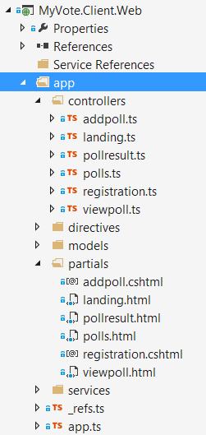
AngularJS – app structure
Controllers | Controllers
Directives | Custom HTML elements: dynamic behaviors.
Models | Data
Partials | Templates (Views)
Services | Services
Modules | Declarative boostrapper

Slide 26
TypeScript
Type-safe, statically-verified JavaScript
IntelliSense!
Sane syntax
Readable, debuggable compiler output
Leverage your C# classes
Notes:
TypeScript vastly amplifies your JavaScript productivity and prepares you for ECMASCRIPT 6
You get to find out if your JS is correct when you WRITE it, not when you RUN it
You get really good IntelliSense
The syntax is non-ambiguous and not too far from JavaScript, while removing a lot of noisy boilerplate
Code output by the TypeScript compiler is easy to read and doesn’t look a lot different from the .ts file. You can step through it in the debugger and not get lost
Use TypeLite to leverage your C# classes and skip the transposition and redundant maintenance issues

Slide 27
Web API
There is no JSON WSDL
TypeScript + TypeLite to the rescue!
MVC developer-friendly
AJAX-friendly
Notes:
1… and, there is no JavaScript CSLA
2. You are writing controllers and actions. No [DataContract]; you’re “close to the wire” and not dealing with leaky abstractions
3. Convention based responses look at Accept header and serve the appropriate response. Being close to the wire lets you shape the response schema
4. Web API 2 – attribute-based routing

Slide 28
Angular + TypeScript + Web Pages
[DEMO]
Bootstrap, routing, poll creation, TypeLite, Web API
Notes:
App.ts for bootstrap and routing
TypeLite exposing our models
Registration.ts for controller / scope
Registration Cshtml with helpers
Web API method in UserController

Slide 29
Key Take-Away: Procedural vs. Declarative
Event-driven manual JavaScript →
Event-driven jQuery →
Declarative Validation (jQuery plugin, native to Angular) →
Code-generated client-side validation declarations (think MVC unobtrusive)

Slide 30
Charts: HighCharts
highcharts.js
Chart library
angular-highcharts.js
Angular directive <highchart config="chartConfig"></highchart>
[DEMO]
Angular directive, chart in markup, controller data-binding
Notes:
[DEMO] pullResult.cshtml, pollResult.ts

Slide 31
SignalR
Real-time push communication
Notifications, streaming, etc.
Azure Web Sites now supports Web Sockets!
[DEMO]
New poll notification
Notes:
Default.cshtml – line 30 – new poll message display
App.ts line 96 – listen for poll added, set new poll count
Signalr.ts – public addPoll, pollAdded listener
OwinStartup.cs – bootstrap to map signalr route
MyVoteHub.cs – send message to all but sender (Clients.Others)

Slide 32
Unit Testing
Jasmine Framework
Mocking
Asserts
Angular Mocks
Runners
Chutzpah (“HUTZpah”)
Karma
Jasmine host page
ReSharper
Coverage
[DEMO]
Notes:
Chutzpah from console w/ coverage

Slide 33
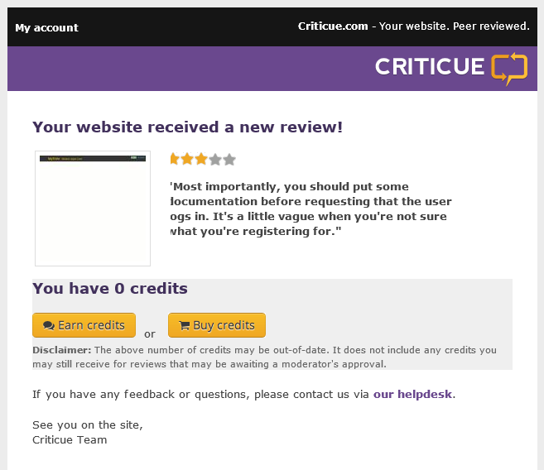
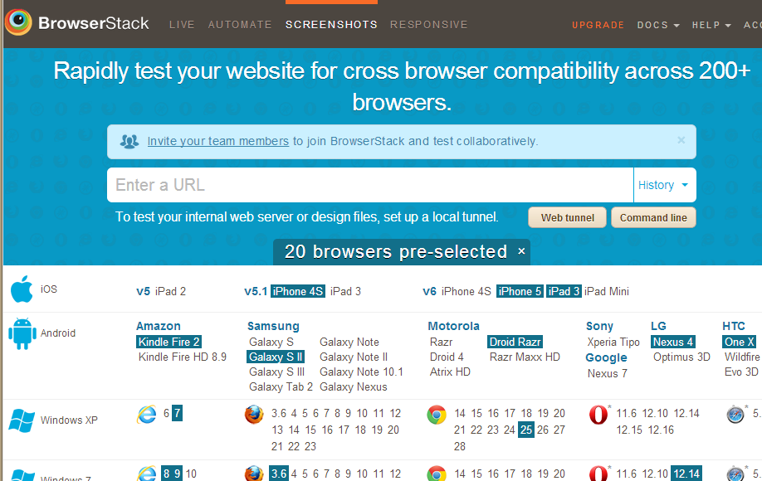
UX Review

Slide 34
Security
Azure Mobile Services JWT
Authentication: leverage ZuMo
Authorization: build your own
[DEMO]
JWT authentication
Generate Sig
Shared Secret
Token Authority (Azure Mobile Services)
Issue
Validate Sig
Client
Present
Server with Resources
Notes:
Authentication lets you claim a unique ID issued from a trusted authority (ZuMo)
ZuMo will tell you someone “is who they say they are” but it’s up to you to decide what you want them to be able to do.
[DEMO] JWT authentication
---- MediaManager / Auth / JsonWebTokenValidationHandler
Impersonation risk if JWT is intercepted or retrieved from localStorage. Can mitigate by requiring login every time, and

Slide 35
Performance
Areas to watch:
Bandwidth
Request count
DOM complexity
JavaScript performance
Techniques
Caching
Bundling / minification
Avoid round trips
RequestAnimationFrame
Tools
New Relic
VS Online Application Insights
Notes:
There are four primary dimensions to SPA performance – bandwidth, request count, DOM complexity, and JavaScript performance.
Bundling & minification, caching, and image spriting let you deal with the network layer issues.
DOM complexity is a design-time issue. Think early and often about trimming the fat in your layouts.
JavaScript performance:
- Cache selectors
- Use $on instead of $click etc. Put your selectors on top-level objects with a selector
- Requestanimationframe

Slide 36
[DEMO]: Bundling/Minification, Monitoring, Monaco
Notes:
Bundle / Min in Global.asax.cs; tweak web.config and show debug vs. release
Application Insights – NOT fully baked, definitely early stages
- Localhost in reporting
Monaco – make a tweak and see it live (start from azure mgmt. portal)

Slide 37
Browser Compatibility
Fallbacks:
HTML5Shiv
Modernizr
JSON2
Polyfills
Testing
Bang for the buck
BrowserStack
Publicity + good logging
Notes:
Browser Compatibility is a constant struggle. There are libraries out there to extend your reach, but they all have drawbacks. First order of business is to understand your audience and tailor your efforts in development and testing.

Slide 38
What We Covered
To the Web!
JavaScript MV* Frameworks
The Stack
Responsive Web Design
AngularJS + TypeScript
Azure Websites and Mobile Services
ASP.NET Web Pages
Web API, CSLA
Testing
Cross-cutting concerns (Security, Performance, Compatibility, etc.)
Notes:
First a general discussion of taking an app to the web – overall pros and cons.
Look at the available JavaScript MVC* frameworks and the factors that go into choosing one.
Remainder of the presentation will start on the front end and work towards the backend:
An overview of the stack chosen for the MyVote HTML5 SPA
Responsive Web Design techniques
Use of Azure Mobile Services from JavaScript
AngularJS with TypeScript
ASP.NET MVC, especially ways to leverage static typing as far into your JavaScript as possible
ASP.NET Web API serving Business Objects from CSLA

Slide 39
Useful Links
MyVote online
http://myvote.azurewebsites.net/
Azure Mobile Services Docs
http://www.windowsazure.com/en-us/develop/mobile/
AngularJS Docs
http://docs.angularjs.org/api
AngularJS Guides
http://egghead.io/
http://thinkster.io/

Slide 40
Questions?

Slide 41
Aidan Ryan
AidanR@magenic.com
@ajryan
http://www.aidanjryan.com
https://github.com/ajryan

